Slide 1
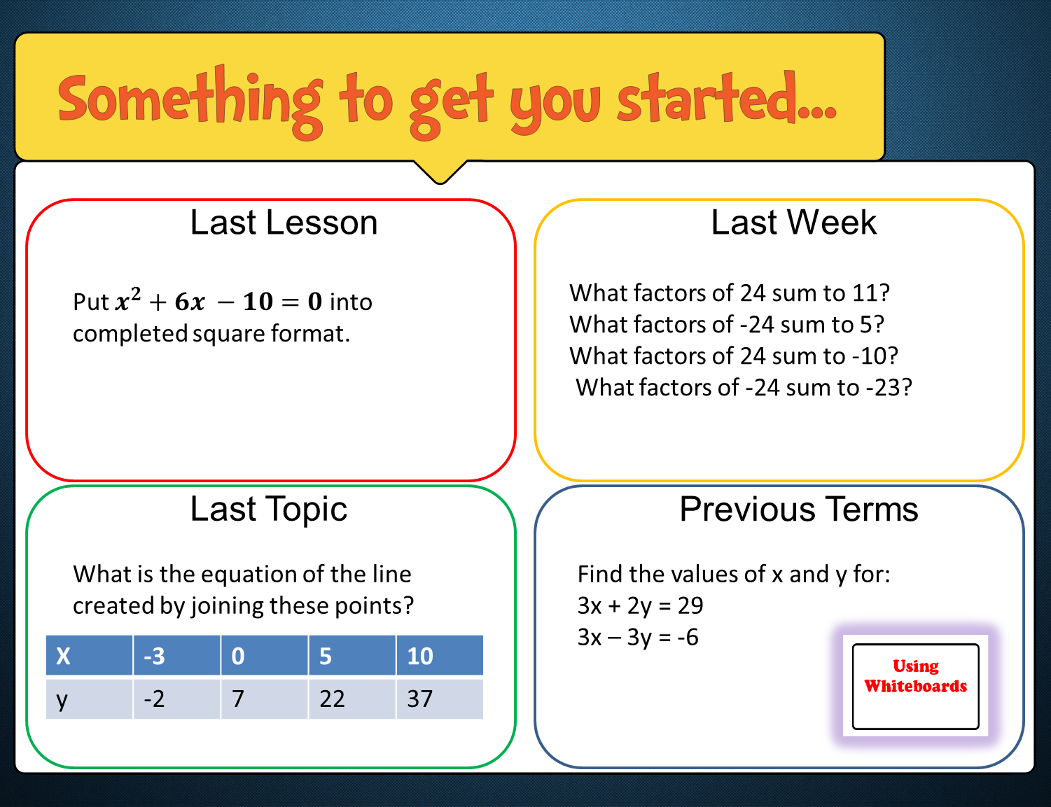

Slide 2




Last Lesson
Last Week
What factors of 24 sum to 11? 8 and 3
What factors of -24 sum to 5? 8 and -3
What factors of 24 sum to -10? -4 and -6
What factors of -24 sum to -23? 1 and -24
$${(x+3)}^{2}−19$$
Last Topic
Previous Terms
$$y=3x+7$$
x=5 y=7

Slide 3
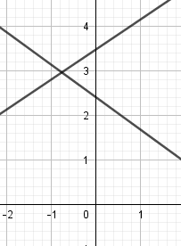
ALGEBRA
Solve Simultaneous Equations Graphically
Identify the gradient and y-intercept of a function
Solve simultaneous equations graphically
Sketch line graphs using m and c

Slide 4



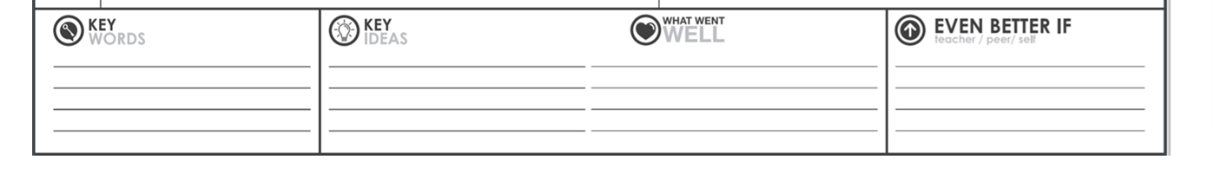
Simultaneous – at the same time
Intercept, c – where two things meet
Gradient, m – the steepness of a line or hill
Standard equation for a straight line graph is:
y = mx + c

Slide 5
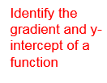
y = mx + c
m is the gradient, or the slope of the graph
c is the y-intercept, or where the graph cuts the y-axis

Slide 6

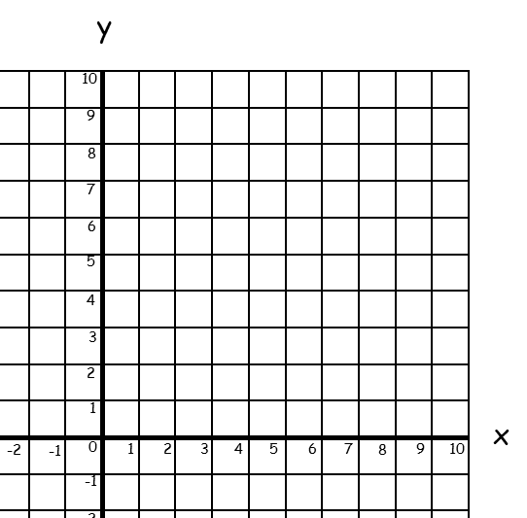
Solve the simultaneous equations y = 2x + 1 and y = 3 graphically:
Start by sketching y = 2x + 1
Start at 1 on the y-axis. Intercept
For every 1 across, go up 2.
Gradient
Join with a straight line.

Slide 7
Solve the simultaneous equations y = 2x + 1 and y = 3 graphically:
Now sketch y = 3.
This means that for every value of x, y = 3.
Find 3 on the y axis and draw a horizontal line through it.

Slide 8
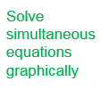
Solve the simultaneous equations y = 2x + 1 and y = 3 graphically:
The solution is the co-ordinate where the graphs cross.
(1, 3)
So x = 1 and y = 3.

Slide 9
Solve the simultaneous equations y = 3x + 2 and y = 6 – x graphically:
Start by sketching y = 3x + 2
Start at 2 on the y-axis.
For every 1 across, go up 3.
Join with a straight line.

Slide 10
Solve the simultaneous equations y = 3x + 2 and y = 6 – x graphically:
Now sketch y = 6 – x.
Start at 6 on the y-axis.
For every 1 across, go down 1.
Join with a straight line.

Slide 11
Solve the simultaneous equations y = 3x + 2 and y = 6 – x graphically:
The solution is the coordinate where the graphs cross.
(1, 5)
So x = 1 and y = 5.

Slide 12
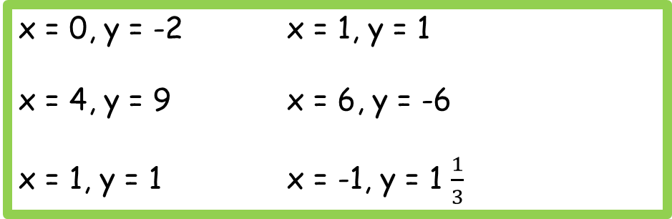
Answers
x = 4, y = 8 x = -2, y = -6
x = 1, y = 3 x = 4, y = 0
x = 2, y = 1 x = 1, y = 4
x = 0, y = -2 x = 1, y = 1
x = 4, y = 9 x = 6, y = -6
x = 1, y = 1 x = -1, y = 1 $\frac{1}{3}$

